Slide 1


Step by Step Instructions

Slide 2
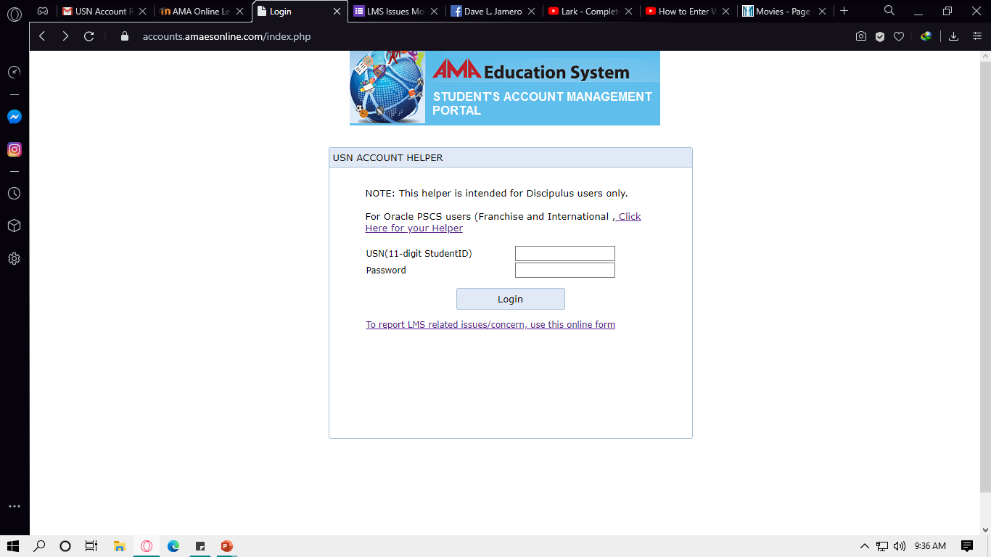
HOW TO LOGIN?
Step 1. Access “accounts.amaesonline.com” input your username and password then click Login.
Note: Once lang dri mag login, after that pwede na mag direct sa “topsite” or your portal and dapat naka lowercase ang pass.

Slide 3
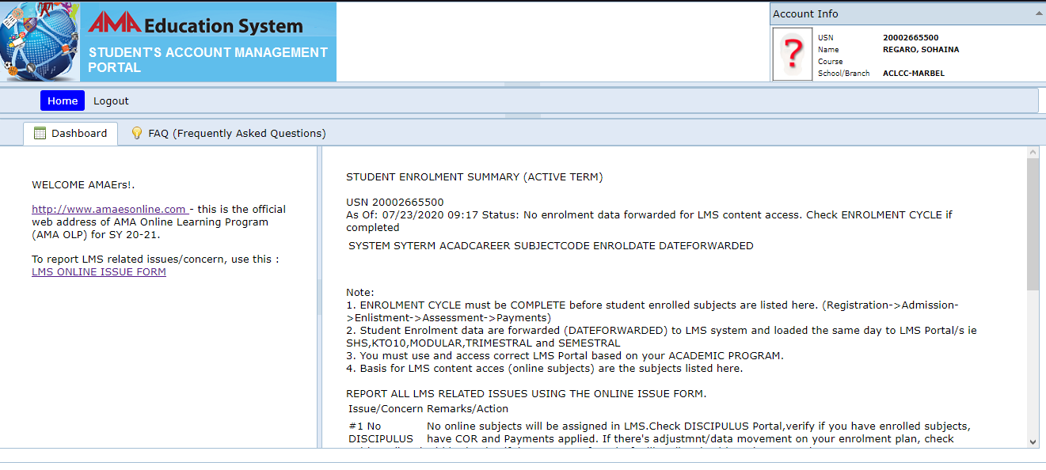
HOW TO LOGIN?
Step 2. After you Login click the link “http://www.amaesonline.com”

Slide 4
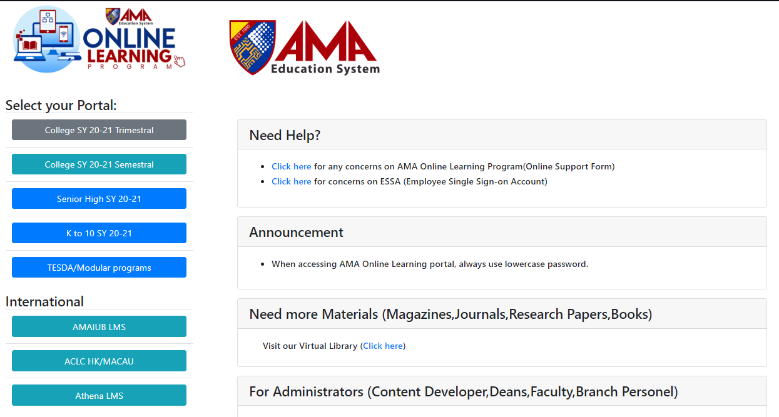
HOW TO LOGIN?
Step 3. Click “Senior High SY 20-21/SEMESTER COLLEGE SY2020-21 For College

Slide 5
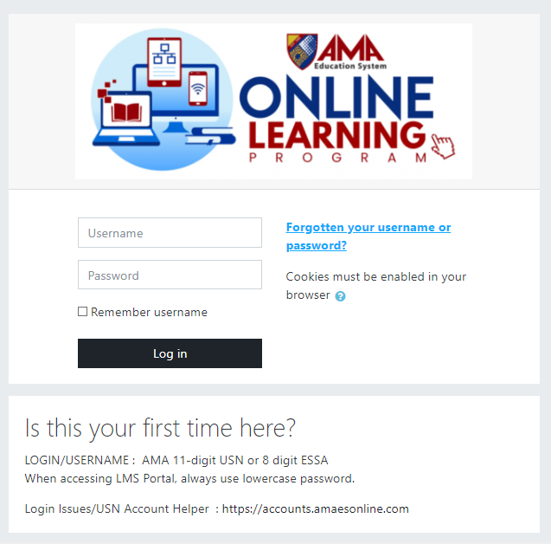
HOW TO LOGIN?
Step 4. Input your username and password
Note: Dapat naka lowercase ang pass

Slide 6
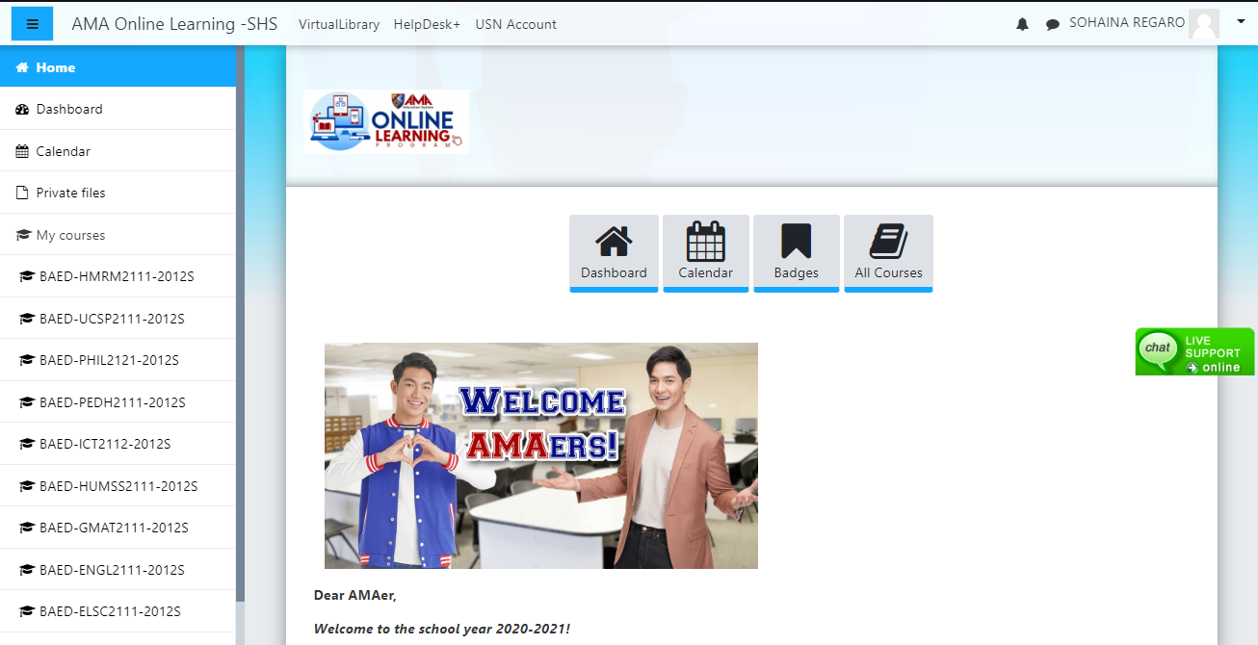
HOW TO TAKE MY QUIZZES AND EXAMS?

Slide 7
After login enter your gmail account

Slide 8
HOW TO REPORT ERRORS?

